Slide 1

Working Capital Management
Financial Management(HS4L003)
Dr. Naresh Chandra Sahu
Associate Professor (Economics)
School of Humanities, Social Sciences & Management
Indian Institute of Technology, Bhubaneswar

Slide 2

Learning Outcomes
Understand the concept and importance of working capital
Differentiate between gross and net working capital
Explain the working capital cycle
Identify factors affecting working capital
Evaluate financing approaches
Apply working capital management techniques in business decisions

Slide 3
Working Capital Management
Working Capital Management (WCM) involves the administration of the firm’s current assets and current liabilities to ensure sufficient liquidity for day-to-day operations while maintaining profitability.
Formula:
Working Capital = Current Assets - Current Liabilities
If a firm has ₹10 lakh in current assets and ₹7 lakh in current liabilities
WC = ₹3 lakh
Is it healthy liquidity?

Slide 4
Components of Working Capital
Current Assets
Cash and Bank Balance: Most liquid asset
Accounts Receivable: Credit sales yet to be collected
Inventory: Raw materials, WIP, Finished goods
Prepaid Expenses: Rent or insurance paid in advance
Short-term Investments: Treasury bills, commercial paper
Current Liabilities
Accounts Payable: Suppliers awaiting payment
Outstanding Expenses: Salaries, utilities due
Short-term Borrowings: Bank overdraft or working capital loan
Bills Payable: Obligations under promissory notes

Slide 5
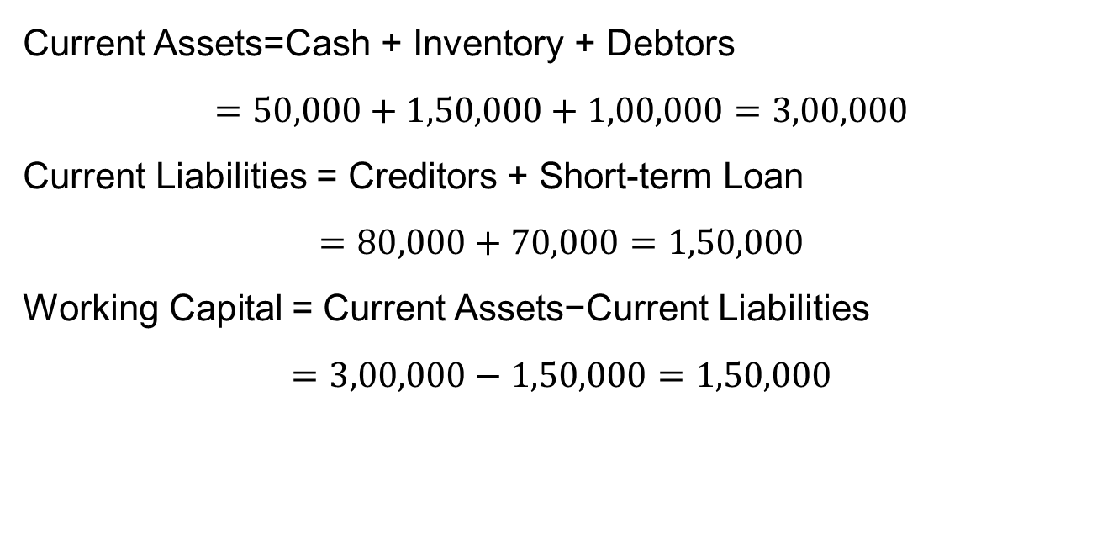
From the following information, calculate Net Working Capital and the Current Ratio of the firm.
Cash = ₹50,000
Inventory = ₹1,50,000
Debtors = ₹1,00,000
Creditors = ₹80,000
Short-term Loan = ₹70,000
Current Assets=Cash + Inventory + Debtors
$$=50,000+1,50,000+1,00,000=3,00,000$$
Current Liabilities = Creditors + Short-term Loan
$$=80,000+70,000=1,50,000$$
Working Capital = Current Assets−Current Liabilities
$$=3,00,000−1,50,000=1,50,000$$

Slide 6
Importance of Working Capital
Key Importance
Ensures uninterrupted production & sales
Maintains adequate liquidity
Enhances creditworthiness with suppliers & banks
Helps achieve operational efficiency
Reduces risk of financial distress
Improves stakeholder confidence

Slide 7
Types of Working Capital
Gross Working capital
Permanent Working Capital
Temporary Working Capital
Net Working Capital
Minimum amount needed always
Current Assets(CA) –Current Liabilities(CL)
Paid in assets other than cash Seasonal or cyclical needs
Total Current Assets

Slide 8
Working Capital Cycle(WCC)
Cash
Work in progress
Finished Goods
Raw Materials
Sales
Receivables

Slide 9
Factors Affecting Working Capital
Nature of Business: Manufacturing needs more WC than service firms
Production Cycle: Longer cycles → higher WC
Business Seasonality: Seasonal firms need variable WC
Credit Policy: More credit to customers → higher WC
Inventory Policy: High stock → more WC
Operating Efficiency: Efficient operations → less WC
Inflation: Increases WC needs

Slide 10
Approaches to Financing Working Capital
Conservative
Long-term funds for both permanent and temporary working capital
Moderate
Long-term for permanent , short-term for temporary working capital
Aggressive
Short-term funds even for permanent working capital

Slide 11
Problems Due to Poor WCM
Stock-outs or overstocking
Delayed payments or credit losses
Low profitability or idle funds
Financial instability

Slide 12
Strategies to Improve Working Capital
Speed up receivables collection
Optimise inventory levels
Negotiate better credit terms with suppliers
Improve cash flow forecasting
Use short-term financing wisely

Slide 13
Thank You

